Slide 1
Cycle Statistic Tool
Cody Klingler & Jacob Hoffman

Slide 2
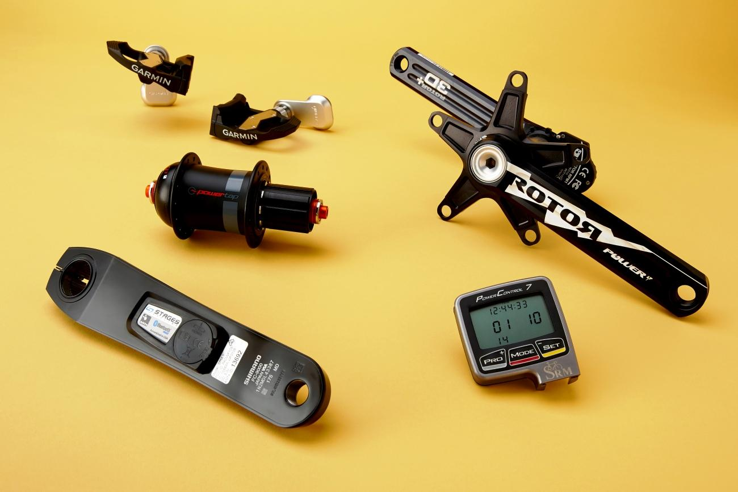
PROBLEM
Available bicycle meters offer very few measurements.
Smart devices do not offer accurate live measurements beyond speed and location.
Notes:
Bicycle meter are tools that allow you measure information about a bicycle as you ride it.
To cyclists, one of the most valuable statistics is power output. Current power meters are expensive ($400) and offer little beyond measuring power.
Smart devices are limited to general information about your cycling like location, speed, and heartbeat.

Slide 3
ENGINEERING TASK
Sensors and components may be used to create a device designed to provide a large collection of cycling data.
Attaching sensors and components directly to the bicycle allows for more specific cycling data to be measured.
Cyclists require a better, more encompassing solution for setting goals and tracking improvement.

Slide 4
PROPOSED SOLUTION
Display | Phone Application
Shows speed, incline, torque, power, calories burned, wind direction, gear ratio and more. Gives live information to the user. | Track trips and records metrics. Statistics about the user’s trip allows for clear goals. Shows the user ways they can improve through statistical trends.

Slide 5
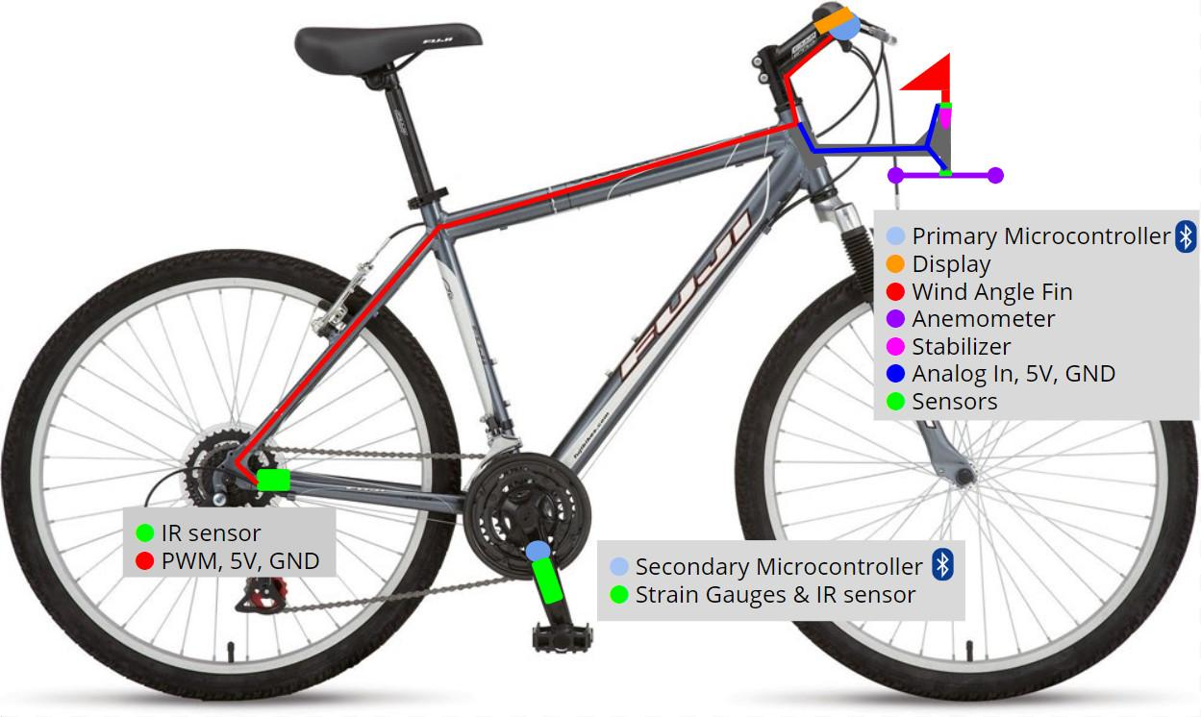
SKETCH

Slide 6
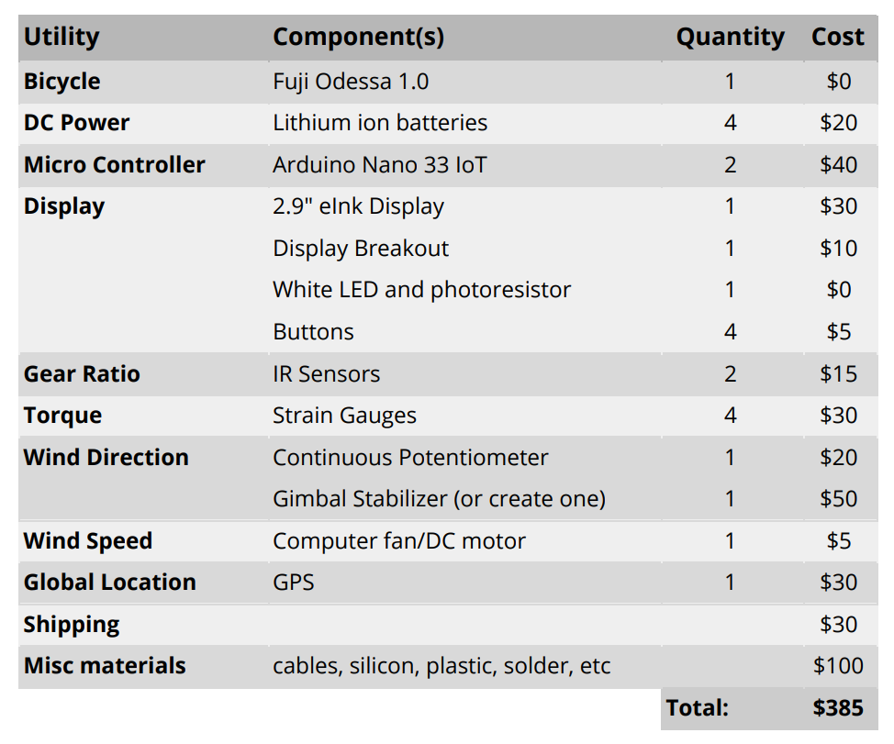
BUDGET

Slide 7
ESTIMATED MAN HOURS
Proposal - 10 hours
Functional Specifications - 10 hours
Time Schedule - 10 hours
Reports - 10 hours
Presentations - 10 hours
Paper Design of Device/General Design of Device Layout - 20 hours
Ordering Parts - 5 hours
Assembly - 40 hours
Hardware Programming - 30 hours
Online Application Programming - 30 hours
Testing/Modifications - 30 hours
Final Documentation - 15 Hours
— TOTAL - 220 HOURS PER PERSON

Slide 8
QUESTIONS?

